Slide 1
CA4009 Video Summarisation
Santiago de Arribas de Renedo
Stephen Stephanov
Fawaz Alsafadi
Eamon El Gendy

Slide 2
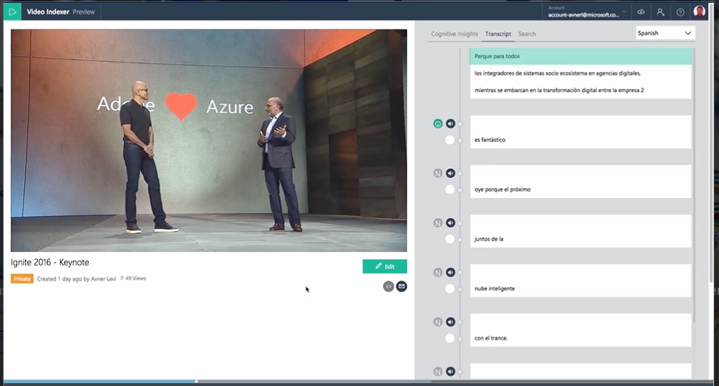
Introduction
Video is becoming more prevalent online.
Need a system to search through this content.
Convention IR systems are unsuitable.
Video summarisation used to break videos down.
Semantic analysis.
Computer vision.
Fig 1.0 Microsoft Video Indexer

Slide 3
User Analysis
The user
Specialized or technical knowledge not required
Designed to be accessible and easy to use
Target audience is any private individual
Using the system
The user provides an object or an event
The user provides a video to be searched
Output
The user is provided a video timestamped with relevant objects and events

Slide 4
Scientific Functional Description
Overall architecture
Front end & back end
Detection Algorithms
Motion, audio and colour
Limitations and assumptions
Hardware, user input, efficacy etc.

Slide 5
Evaluation
Evaluation strategy( summary comparisons)
Evaluation objective(System works perfectly…)
Data used for evaluation(Videos from various categories,irrelevant/relevant queries)
Search queries used for functionality assessment.(Comma separated words/short sentences)
How are we going to collect data? Testing( Users/Us/Computer generated)
What metrics are we going to use to evaluate the performance?

Slide 6
Conclusion
System will enable user to search a video using Video Summarisation
This will use audio semantic analysis and image processing
User doesn’t require technical knowledge to use the system
The system uses a client-server architecture
Will be evaluated with a set of videos which match a query
Users query should match related sections of video returned by the system

Slide 7
Thank you.

